Slide 1
A Guide To Handling and Presenting Frames

Slide 2
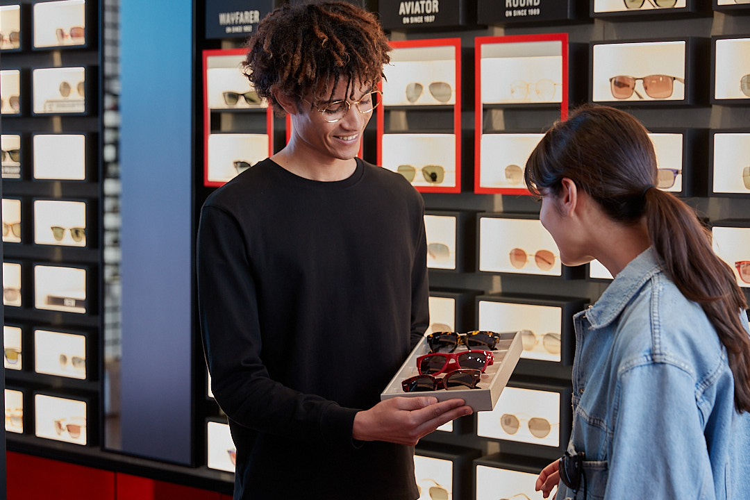

Why Knowing How To Handle Frames Matters
In your daily work, frames are among the most valuable items in-store and should be handled with the utmost care, especially when presenting them to customers.
Careful handling will ensure their safety and longevity while also showcasing your professionalism, attention to detail, and respect for their value. More importantly, handling frames with confidence will reassure your customers that they're receiving high-quality service and that their purchase is in good hands.
To achieve this, your responsibilities include:
Handling frames with caution
Cleaning them thoroughly
Making sure they fit customers properly
Presenting and explaining the features, materials, and benefits of each frame
Remember
Mastering these skills will build trust and reinforce the value of both the frames and your service.

Slide 3
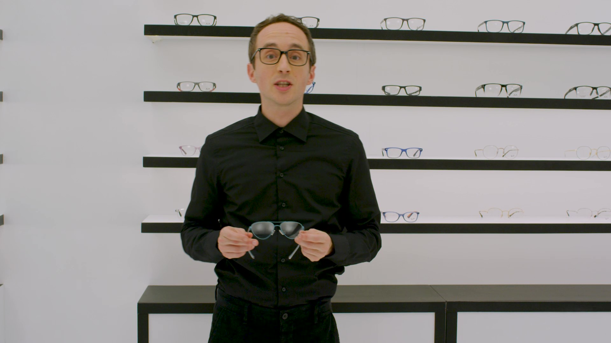
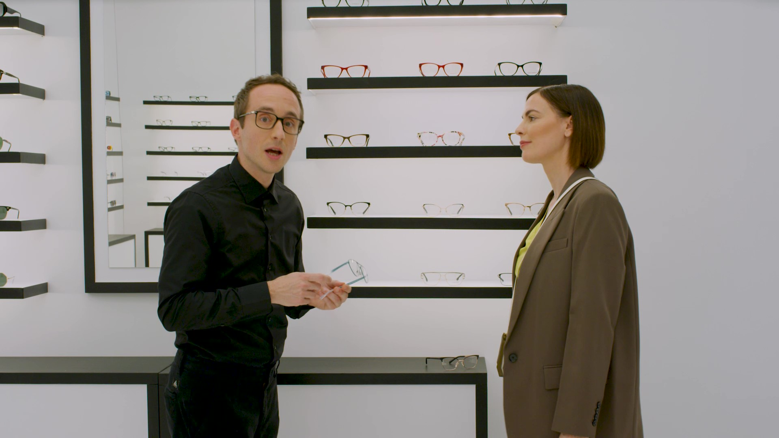
The Fundamental Rules for Presenting Frames
To be a trusted frame advisor, the way you handle and present frames to customers matters a lot. In fact, it's essential to know the best way to do it, as it directly impacts the customer experience.
The more you practice these fundamental rules, the more confidently and easily you'll be able to apply them:
RULE 1
Highlight the Unique Details of Each Frame
When presenting eyewear to a customer, make sure to point out any interesting details. This could include special logos on the temples, the use of refined materials, or flexible hinges.

Slide 4
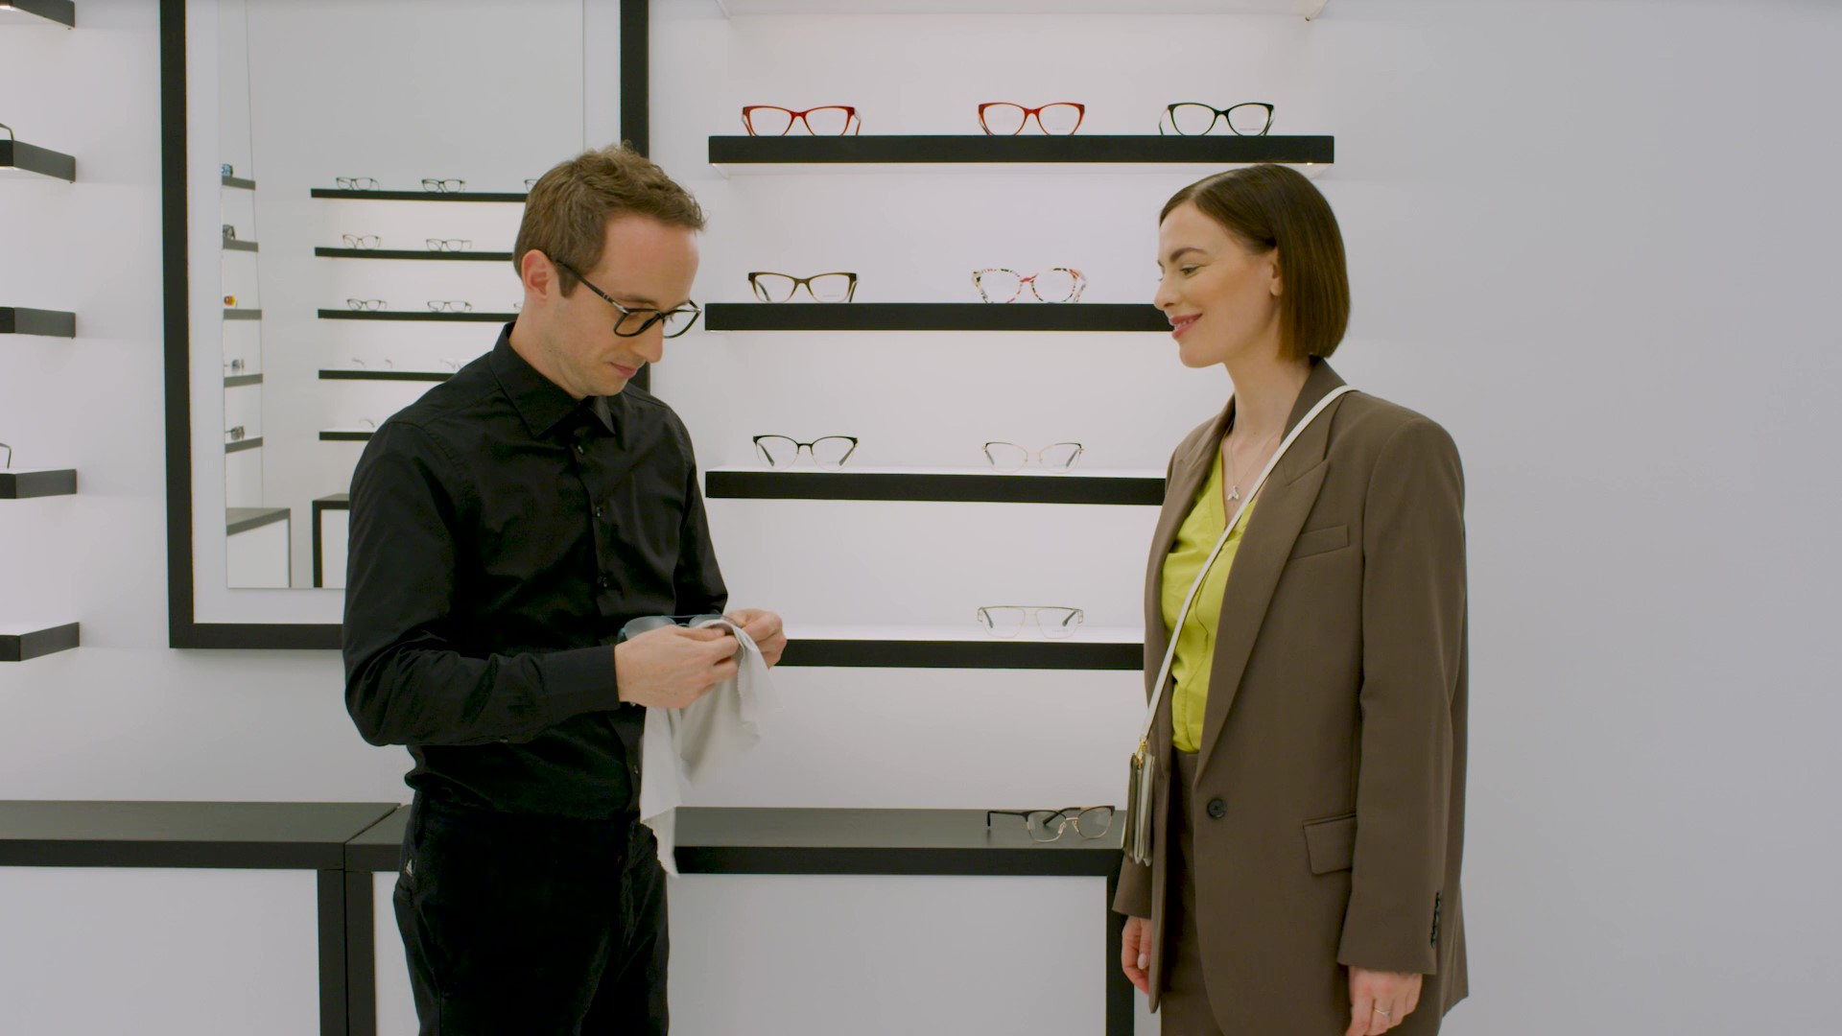

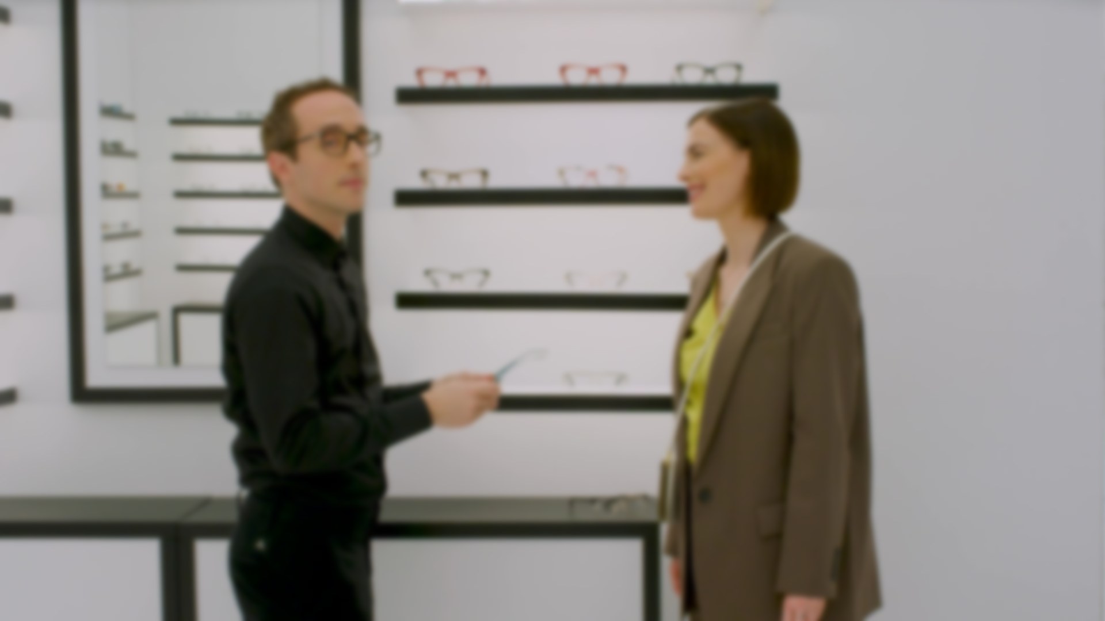
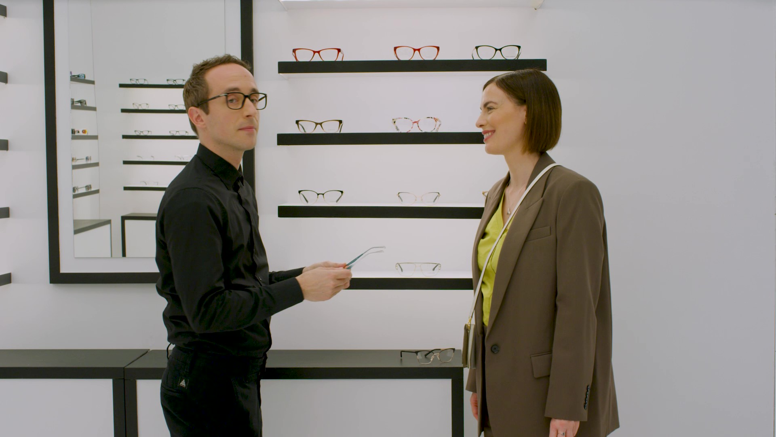
RULE 2
Clean the Eyewear With a Microfiber Cloth
Before letting your customer try on the eyewear, always clean it with a microfiber cloth to ensure it's spotless.
Remember
If the customer is wearing their own eyewear, be sure to give them enough time to remove it and place it in a safe place before trying on the new pair you're proposing.
RULE 3
Hold the Frame by the Front and Let the Customer Take It by the Temples
After cleaning the eyewear and putting away your cloth, hold the frame by the front and hand it to the customer to hold by the temples. This way, the customer can try on the eyewear without touching the lenses.

Slide 5
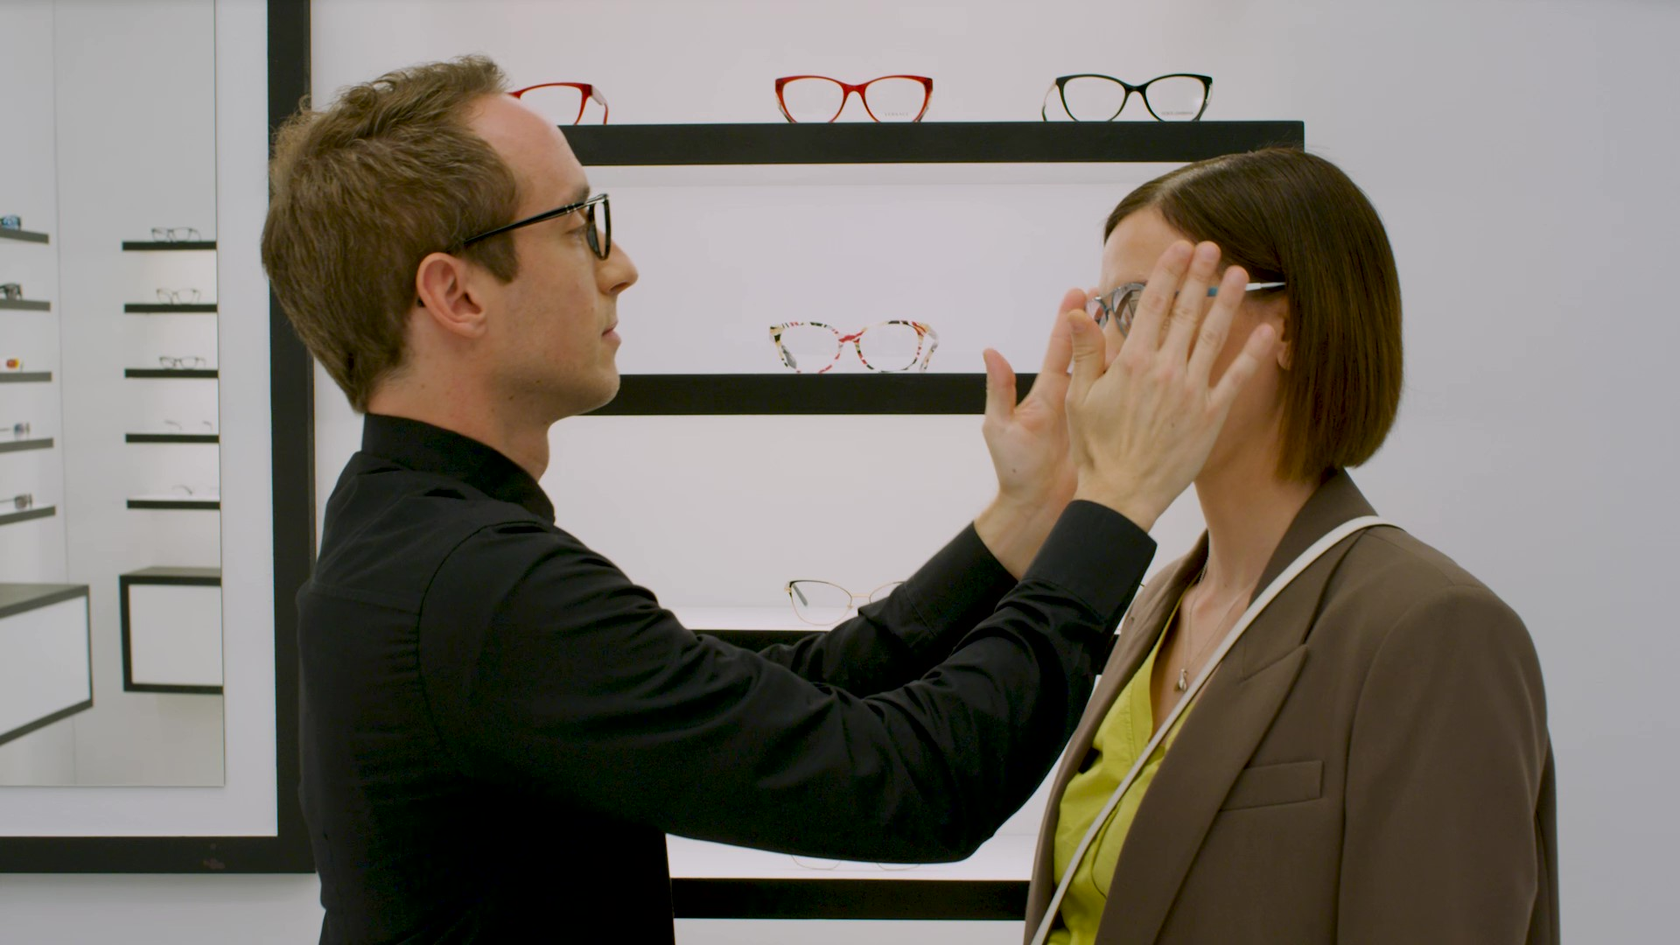
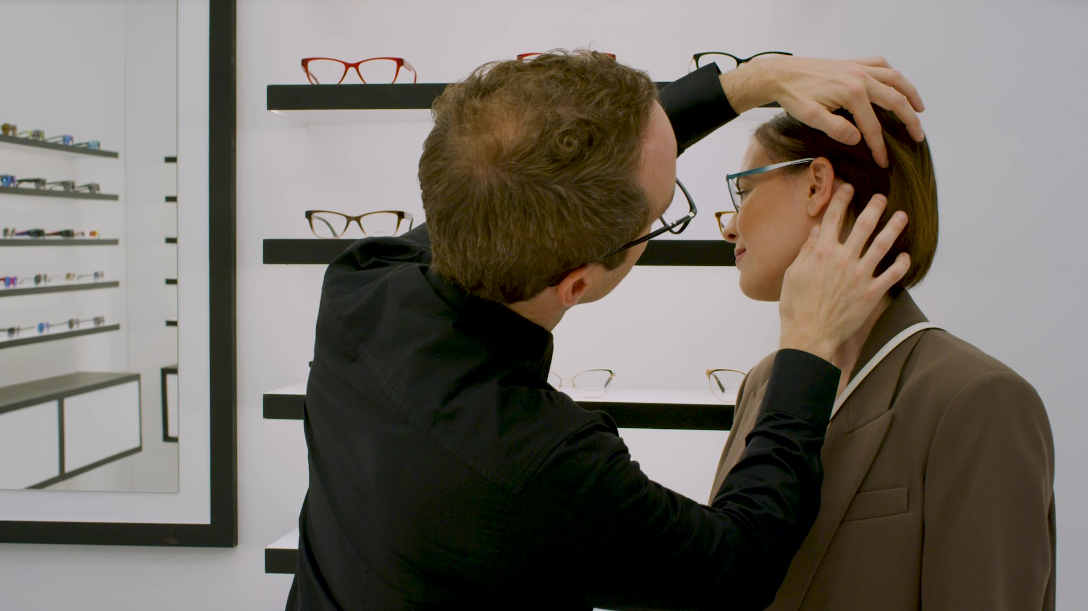
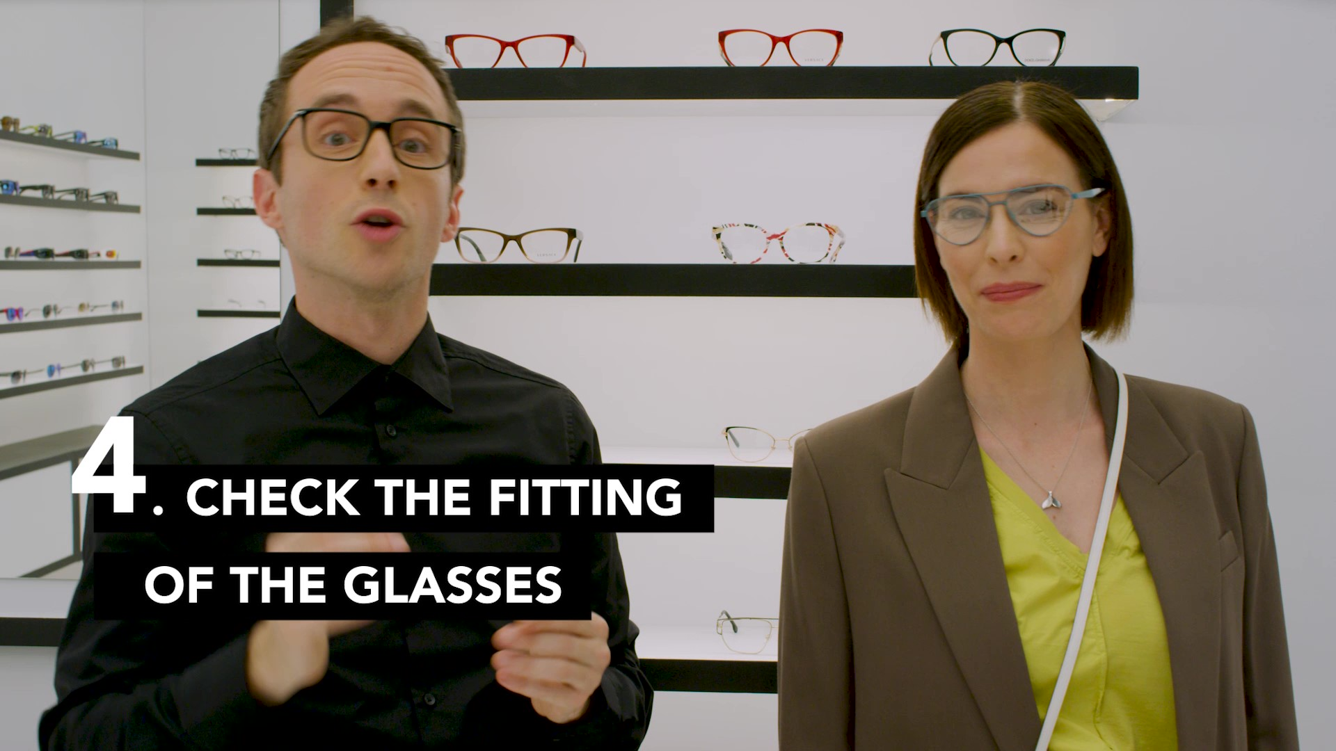
RULE 4
Check the Fit of the Eyewear
Once the customer is standing in front of you wearing the eyewear, a crucial phase begins: checking how the eyewear fits.
The three most important things to check are:
Nose pads
The nose pads should rest firmly on the nose without leaving marks. Ask the customer to adjust the frame slightly and check for any indentations. Be sure to show them that there are no indentations — it's a great way to involve them in the process.
Temples
The temples should fit comfortably around the ears without hurting them. Make sure they are the right length, neither too short nor too long.
Fit and bridge alignment
The frame should fit snugly without slipping, and the bridge should be horizontally aligned with the face. It should not be too tight or too large.

Slide 6
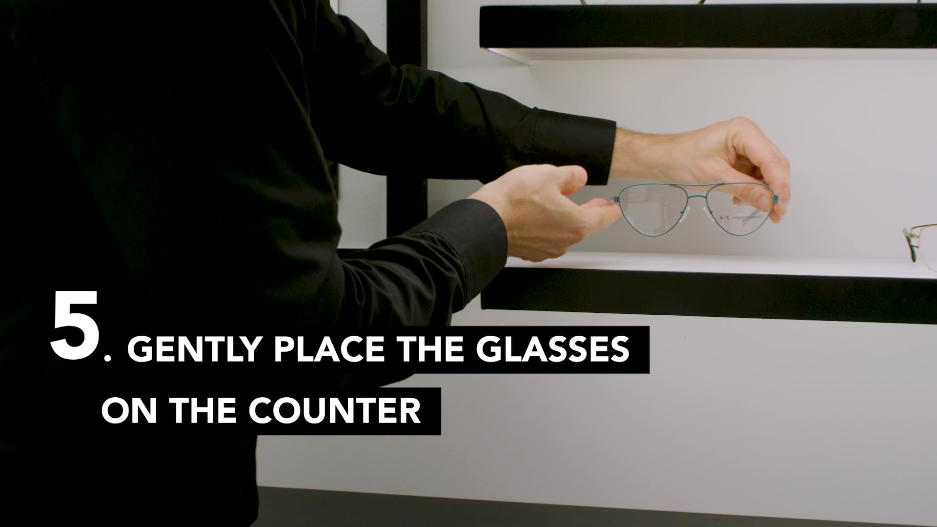
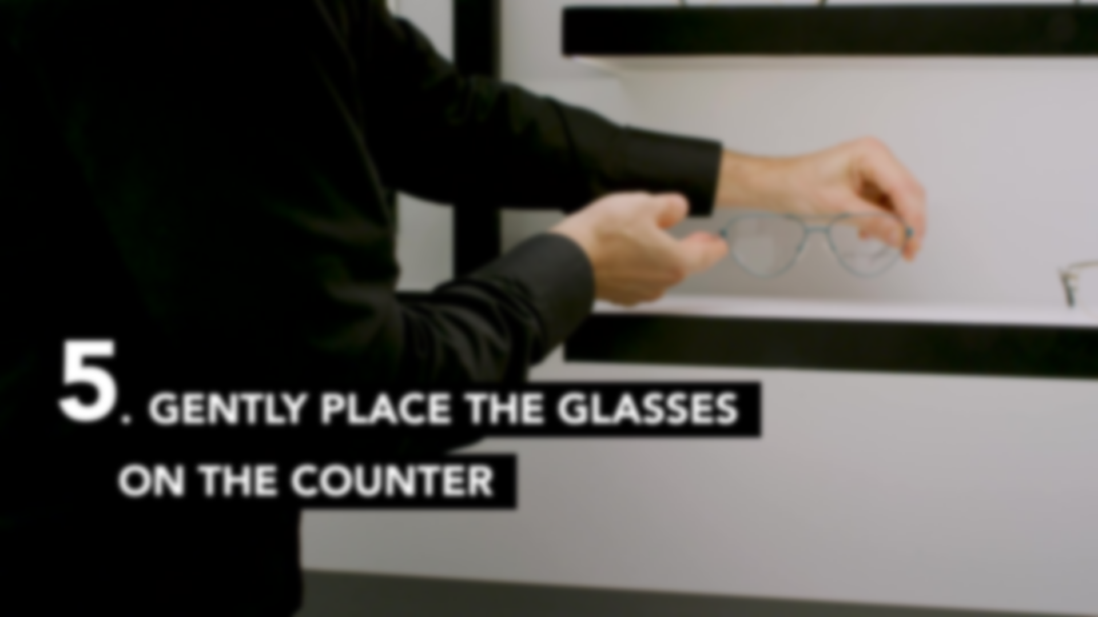
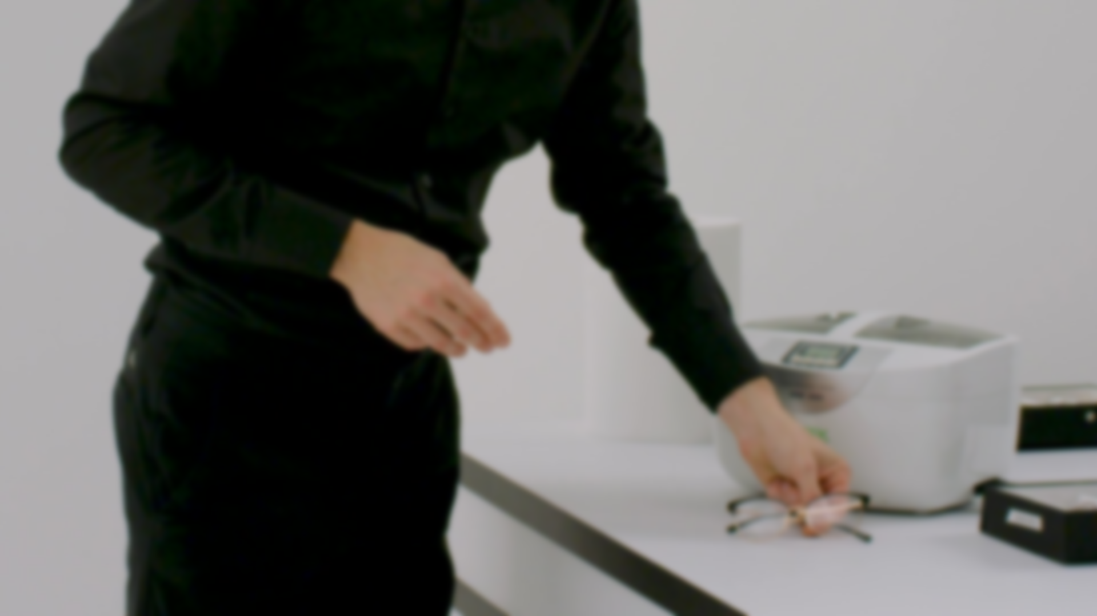

RULE 5
Gently Place the Eyewear on the Counter
When the customer removes the eyewear, always encourage them to place it gently on the counter, assisting them if needed. This helps prevent scratches and maintains the frame's integrity.
By consistently applying these straightforward yet effective rules, you'll find that proper frame handling is a significant advantage when interacting with customers.
RULE 6
Offer Eyewear Cleaning and Maintenance to the Customer
Always offer your customers and anyone accompanying them complimentary maintenance for their personal eyewear. This could include ultrasonic cleaning to remove dirt and debris, replacing worn or damaged nose pads if they are in bad shape, tightening screws in hinges, and making any necessary adjustments to ensure a perfect fit.

Slide 7
Exceeding Expectations With the Collection
When a customer comes to collect their new eyewear, you have another opportunity to create a memorable experience by reconnecting with them and demonstrating your expertise, ensuring they feel well assisted even after the initial purchase. Be attentive, inspect the eyewear together, and make sure everything is flawless: the correct prescription, a perfect fit, and no defects.
Discuss Aftercare and Cleaning Accessories
Customers often have questions about cleaning, adjustments, and general frame care. Providing this information and guidance at the time of collection will help them keep their eyewear in top condition for longer.
Take the time to demonstrate proper cleaning techniques and aftercare. This will not only improve their in-store experience but also help them get the most out of their new frames for a long time to come.
Remember
Show your customer that their satisfaction is just as important to you as it is to them. Take the opportunity to reassure the customer about their purchase, encouraging them to try on the eyewear and making the moment feel special by with these key actions:
Present the eyewear like a piece of jewelry: Handle it with care and showcase it with confidence.
Highlight the frame's unique qualities: Eyewear isn't just about vision — it's about style. Point out what makes the frame special and how it enhances their features.
Reiterate the benefits: Remind them why they chose this frame and how it suits their needs and lifestyle.
Show off the case: Present the case with the same attention to detail, emphasizing how it protects and complements their new eyewear.
Remember
To exceed expectations, make it your mission to ensure that customers leave your store with the knowledge and confidence to properly care for their eyewear — along with the lasting impression of your excellent service.

Slide 8
© 2025 EssilorLuxottica Group. All images and text in this tool are protected by copyright laws and are for internal use only. They may not be used or reproduced in any form or manner without the prior written permission of EssilorLuxottica Group, or in the case of third-party materials, the owner of that content.

